Slide 1

Ground rules

Slide 2

Ground rules

Slide 4


Slide 5
Thomas Bayes
1702-61

Slide 6

?
Thomas Bayes
1702-61

Slide 7
Frequentists
P(Evidence | Hypothesis)

Slide 8
Bayesian
P(Hypothesis | Evidence)

Slide 9
Bayes Theorem
P(E|H)
P(H)
P(H|E)
=
P(E)

Slide 10
Probability of
H given E
P(E|H)
P(H)
P(H|E)
=
P(E)

Slide 11
Posterior
probability
P(E|H)
P(H)
P(H|E)
=
P(E)

Slide 12
The Likelihood
P(E|H)
P(H)
P(H|E)
=
P(E)

Slide 13
The Prior
P(H)
P(E|H)
P(H|E)
=
P(E)

Slide 14
P(E|H)
P(H)
P(H|E)
=
P(E)
The probability of E over all possibilities

Slide 15
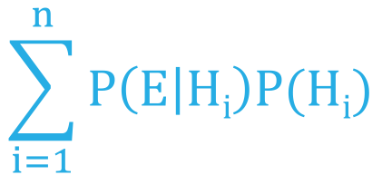
P (E|H)
P (H)
P (H|E)
=
$$\sum_{i=1}^{n}{P\left(E | Hi\right)P(Hi)}$$
The probability of E over all possibilities

Slide 16
Bayes Theorem
P(E|H)
P(H)
P(H|E)
=
P(E)

Slide 17
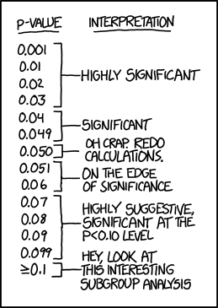

Slide 19
Bayes Theorem
P(E|H)
P(H)
P(H|E)
=
P(E)

Slide 20
P (E|H)
P (H)
P (H|E)
=
$$\sum_{i=1}^{n}{P\left(E | Hi\right)P(Hi)}$$
The probability of E over all possibilities

Slide 21

Monte Carlo Markov Chain

Slide 22
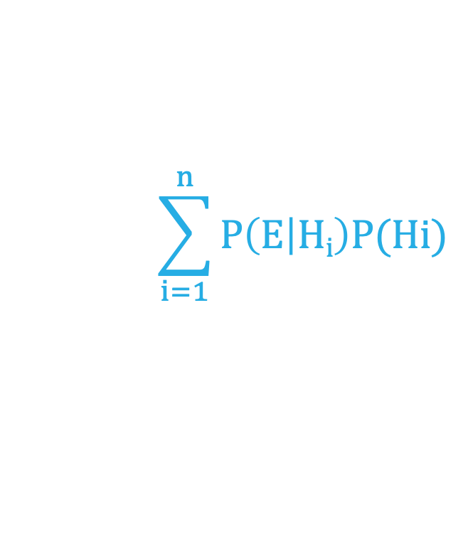
MCMC chains will allow us to forget about the denominator and use:
P (E|H)
P (H)
P (H|E)
=
$$\sum_{i=1}^{n}{P\left(E | Hi\right)P(Hi)}$$

Slide 23
MCMC chains will allow us to forget about the denominator and use:
P(H|E)
P(E|H)
P(H)
~

Slide 24
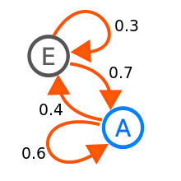
Markov Chain

Slide 26
Linear model
y = β₀ + β₁
β₀ is the intercept
β₁ is the slope
y
β₀
β₁
x₁
x₁

Slide 27
Linear model
y = β₀ + β₁
β₀ is the intercept
β₁ is the slope
y
β₀
β₁
x₁
x₁

Slide 28
Generalized Linear model
y = β₀ + β₁
y
x₁

Slide 29

Generalized Linear model
y = β₀ + β₁x₁
y
x₁

Slide 30
Markov Chain

Slide 31
Monte Carlo Markov Chain
y = β₀ + β₁x₁

Slide 32



Monte Carlo Markov Chain
X₀
y = β₀ + β₁x₁

Slide 33
Monte Carlo Markov Chain
X₀
y = β₀ + β₁x₁

Slide 34
P(H|E)
P(E|H)
P(H)
~

Slide 35
P(X₀ |E)
P(E|X₀)
P(X₀)
~

Slide 36
Monte Carlo Markov Chain
X₀
y = β₀ + β₁x₁

Slide 37
Monte Carlo Markov Chain
X₀
X_{t}
y = β₀ + β₁x₁

Slide 38
P(X₀ |E)
P(X_{t} |E)

Slide 39
P(X₀ |E)
P(E|X₀)
P(X₀)
~

Slide 40
P(X₀ |E)
P(E|X₀)
P(X₀)
~
P(X_{t} |E)
P(E|X_{t})
P(X_{t})

Slide 41
Monte Carlo Markov Chain
X₀
X_{t}
y = β₀ + β₁

Slide 42
Monte Carlo Markov Chain
X₀
X_{t}
y = β₀ + β₁
P(E|X_{t})
P(X_{t})
P(E|X₀)
P(X_{o})

Slide 43
Monte Carlo Markov Chain
X₀
X_{t}
y = β₀ + β₁
P(E|X_{t})
P(X_{t})
P(E|X₀)
P(X_{o})

Slide 44

Monte Carlo Markov Chain
X₀
X_{t}
y = β₀ + β₁
P(E|X_{t})
P(X_{t})
P(E|X₀)
P(X_{o})
>1
X_{t}

Slide 45
Monte Carlo Markov Chain
X₀
X_{t}
y = β₀ + β₁
P(E|X_{t})
P(X_{t})
P(E|X₀)
P(X_{o})
<1
Go to X_{t}
with the probability
P(E|X_{t})
P(X_{t})
P(E|X₀)
P(X_{o})

Slide 46
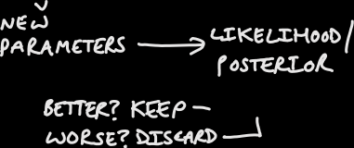


Monte Carlo Markov Chain
X₀
X_{t}
y = β₀ + β₁
P(E|X_{t})
P(X_{t})
P(E|X₀)
P(X_{o})
P(E|X_{t1})
P(X_{t1})
P(E|X_{tx})
P(X_{tx})

Slide 47

Monte Carlo Markov Chain
X₀
X_{t}
y = β₀ + β₁
P(E|X_{t})
P(X_{t})
P(E|X₀)
P(X_{o})
P(E|X_{t1})
P(X_{t1})
P(E|X_{tx})
P(X_{tx})

Slide 48
Remember this guy
P (E|H)
P (H)
P (H|E)
=
$$\sum_{i=1}^{n}{P\left(E | Hi\right)P(Hi)}$$
The probability of E over all possibilities

Slide 49
P (X_{t}|E)
=
P (X₀|E)

Slide 50
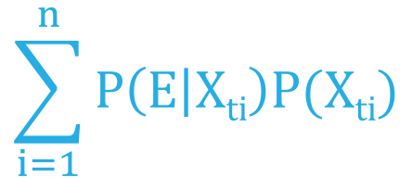
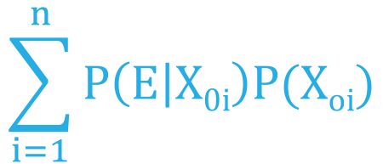
P (E|X_{t})
P (X_{t})
$$\sum_{i=1}^{n}{P\left(E | Xti\right)P(Xti)}$$
P (X_{t}|E)
=
=
P (X₀|E)
P (E|X₀)
P (X₀)
$$\sum_{i=1}^{n}{P\left(E | X0i\right)P(Xoi)}$$

Slide 51
P (E|X_{t})
P (X_{t})
$$\sum_{i=1}^{n}{P\left(E | Xti\right)P(Xti)}$$
P (X_{t}|E)
=
=
P(E|X_{t})
P(X_{t})
P (X₀|E)
P(E|X₀)
P(X_{o})
P (E|X₀)
P (X₀)
$$\sum_{i=1}^{n}{P\left(E | X0i\right)P(Xoi)}$$

Slide 52
Monte Carlo Markov Chain
X₀
X_{t}
y = β₀ + β₁
P(X_{t})
Posterior X_{t}
Posterior X₀
P
Posterior X_{t2}
Posterior X_{t1}

Slide 53
Lets do some examples

